Slide 1
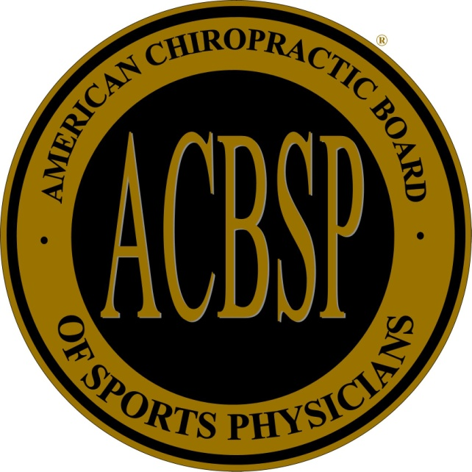
Highly Specialized Care…Available Locally
Diplomate of the American Chiropractic Board of Sports Physicians (DACBSP) is the highest accredited board certification in chiropractic sports medicine.
Dr. Richard Foveaux DC, DACBSP was the first and only one of two chiropractors in the state to have achieved the status of DACBSP.
There are less than 400 DACBSP’s in the world. Others can be found working with professional sports teams, or managing the US Olympic Training Center sports medicine clinics.

